Slide 1
Storybook Mode 1 Rough Draft #1.1
Bard from Racha Den DEMO
15 August 2023

Slide 2
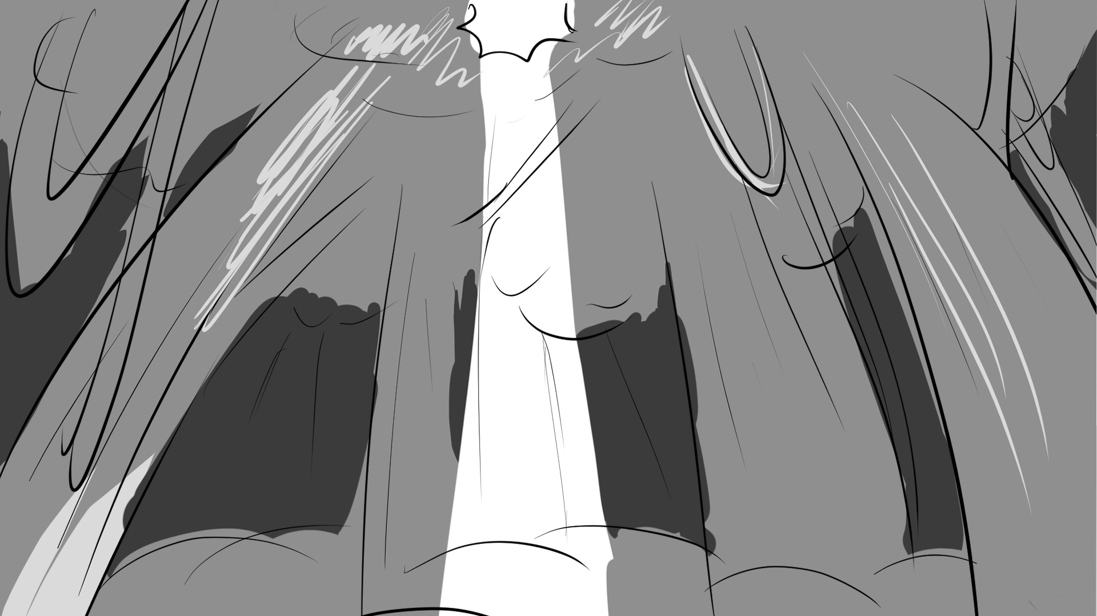
As Deanna came to, she first sensed the rainforest’s song of chirping crickets and chattering cicadas.
Notes:
FLASH IN or WHITE IN to “bg stb1_page 1.” / Text box FADES IN and OUT on BOTTOM. / TILT DOWN to “bg stb1_page 2”

Slide 3
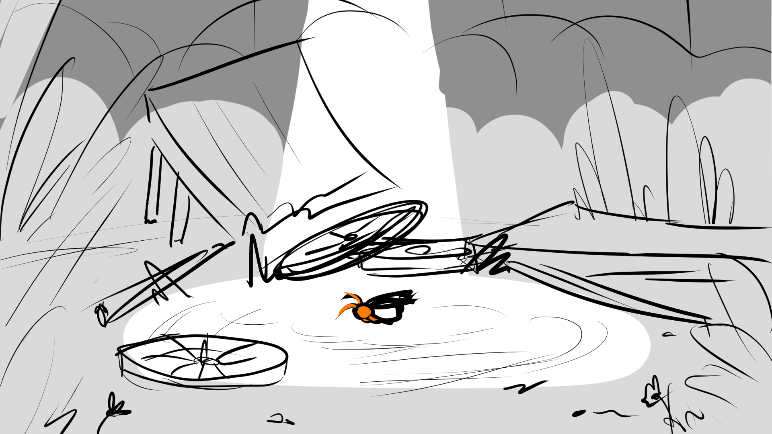
The air, perfumed with rich earth and tropical flowers, suppressed the forest floor with heavy humidity.
Notes:
ESTABLISHING SHOT “bg stb1_page 2” / ZOOM IN on DEANNA / FADE TO “bg stb1_page 3”

Slide 4
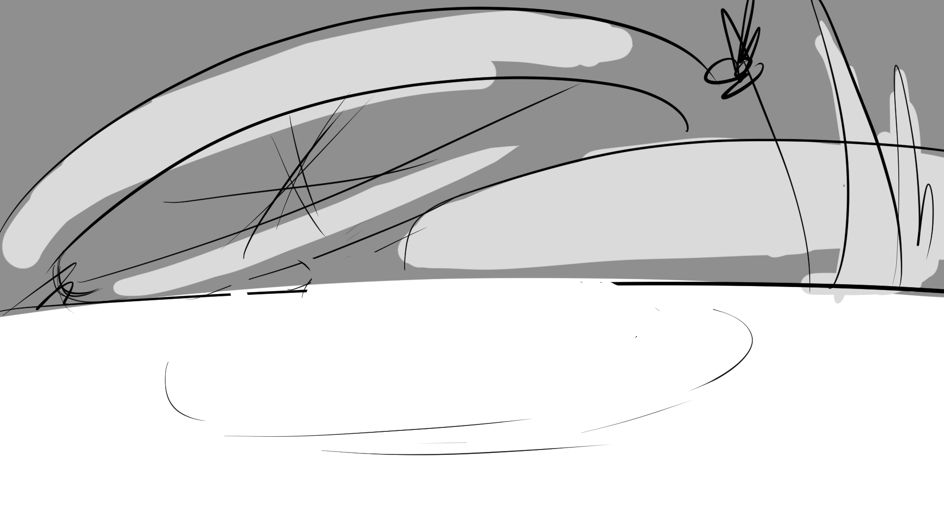
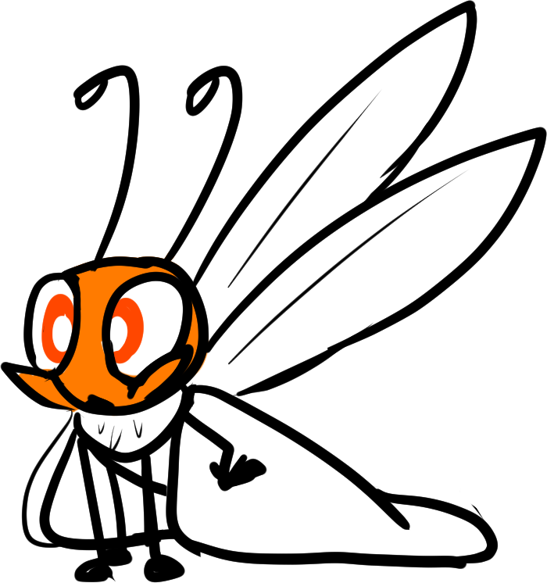
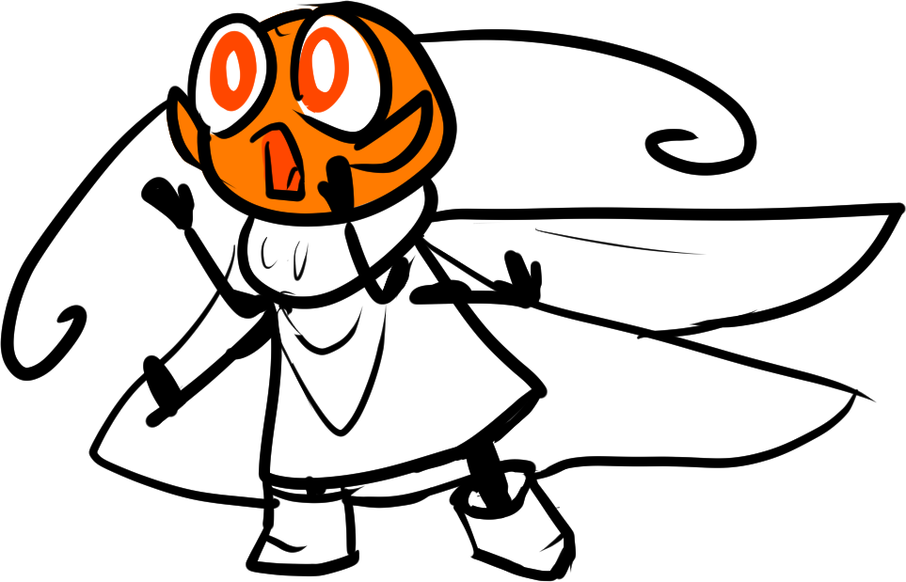


Deanna
Deanna finally awoke among the ruins of what was left of their getaway wagon. She immediately realized something amiss.
Her friends weren’t with her!
“Lethabo! Athos! Where are you?”
Deana listened for any signs of her friends…
Notes:
WIDE SHOT of DEANNA ASLEEP / Animation: Deanna waking up / D MOVE LEFT when calling out

Slide 5
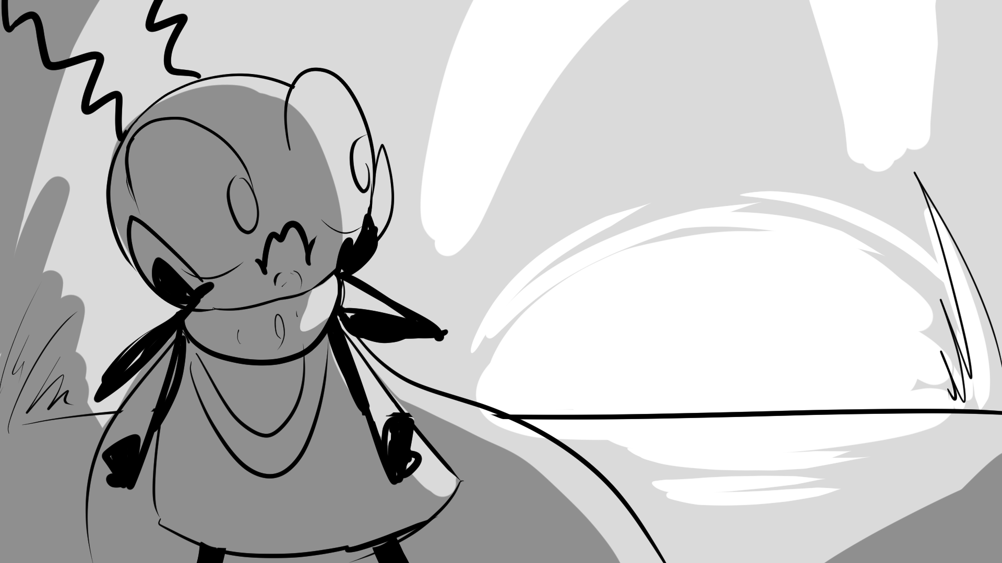


Deanna heard shuffling behind her! Beyond the ditch, there rumbled a grouchy moan.
Suddenly--!
Notes:
EST. SHOT “bg stb1_page 4” / ANIMATE “stbl_page4_sfx 1” and “sfx 2” first round / Text “SUDDENLY” is automatic after first round of SFX / Commence 2nd round of SFX

Slide 6
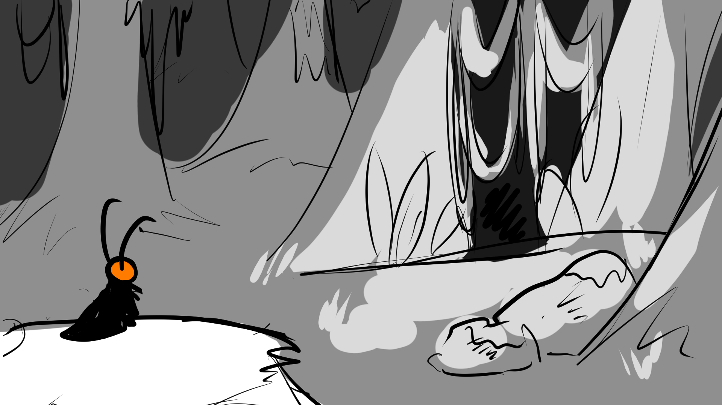
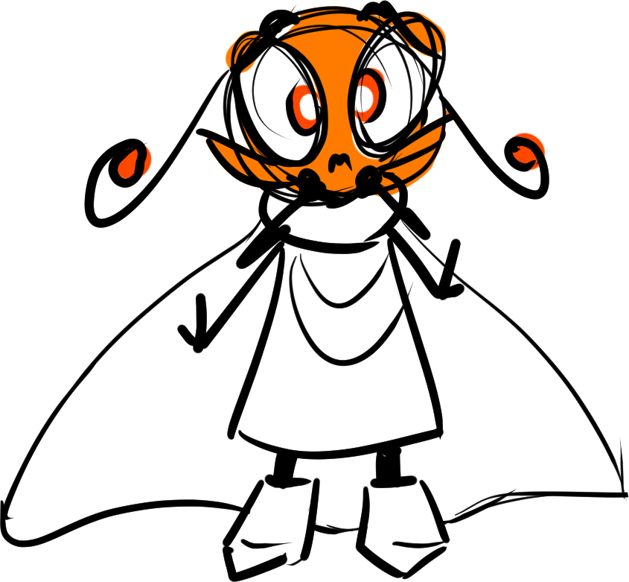
Deanna
Deanna had no choice but to investigate. Her friends could be in trouble!
Further down the hill, Deanna beheld a stretch of entangling vines and wild grass.
“L-Lethabo? Athos? Is th-that you?”
Notes:
EST SHOT “bg stb1_page 5” / FADE IN “deanna_close_scared” due left with dialogue / FADE OUT “deanna_close_scared” / FADE OUT text box / FADE TO BLACK

Slide 7
END OF Storybook Mode 1
TRANSITION TO Explore Mode 1

